Slide 1
Chapter-4:
How Objects Behave
Upcode Software
Engineer Team
-2023-

Slide 2
CONTENT
What is Object Behave ?
You can send and return objects to a method.
You can send more than one thing to a method.
What is String pool ?
Encapsulation in an object.
How do objects in an array behave ?

Slide 3
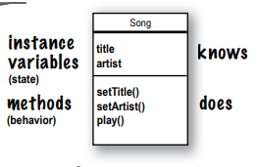
What is Object Behave ? (1/n)
A class is the blueprint for an object.
When you write a class, you’re describing how the JVM should make an object of that type.
You already know that every object of that type can have different instance variable values.
Remember: a class describes what an object knows and what an object does

Slide 4
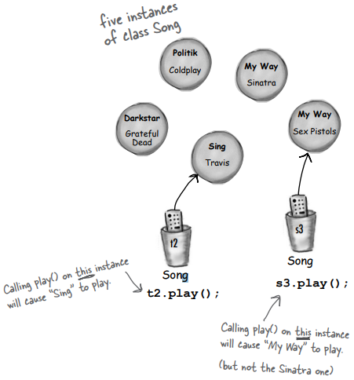
What is Object Behave ? (2/n)
Can every object of that type have different method behavior?
Every instance of a particular class has the same methods, but the methods can behave differently based on the value of the instance variables.
void play() { soundPlayer.playSound(title);
}
Song t2 = new Song(); t2.setArtist(“Travis”); t2.setTitle(“Sing”); Song s3 = new Song(); s3.setArtist(“Sex Pistols”); s3.setTitle(“My Way”);

Slide 5
You can send and return objects to a method. (1/n)
Just as you expect from any programming language, you can pass values into your methods.
Depending on your programming background and personal preferences, you might use the term arguments or perhaps parameters for the values passed into a method.
So you can call them whatever you like (arguments, donuts, hairballs, etc.) but we’re doing it like this:
A method uses parameters. A caller passes arguments.
Arguments are the things you pass into the methods.
And a parameter is nothing more than a local variable. A variable with a type and a name, that can be used inside the body of the method.

Slide 6
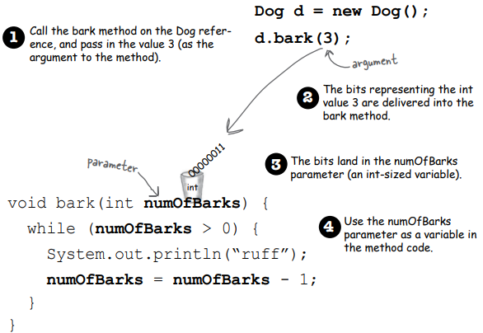
You can send and return objects to a method. (2/n)
But here’s the important part: If a method takes a parameter, you must pass it something. And that something must be a value of the appropriate type.

Slide 7
You can send and return objects to a method. (3/n)
You can get things back from a method.
Methods can return values. Every method is declared with a return type, but until now we’ve made all of our methods with a void return type, which means they don’t give anything back.
But we can declare a method to give a specific type of value back to the caller, such as:
void go() { }
int giveSecret() {
return 42;
}

Slide 8
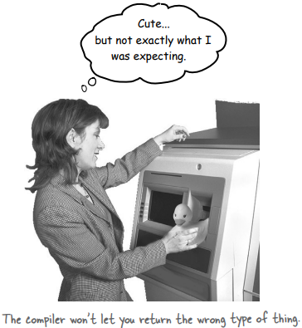
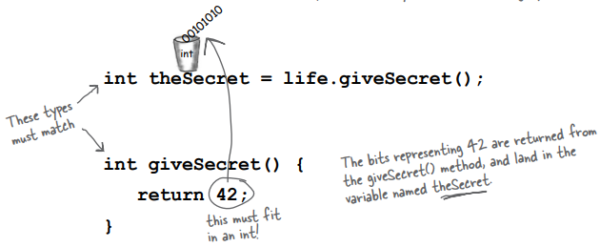
You can send and return objects to a method. (3/n)
If you declare a method to return a value, you must return a value of the declared type! (Or a value that is compatible with the declared type.
Whatever you say you’ll give back, you better give back!

Slide 9
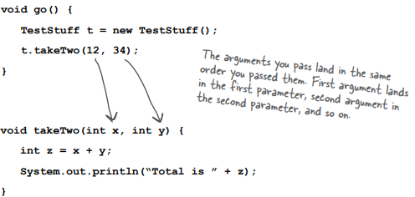
You can send more than one thing to a method. (1/n)
Methods can have multiple parameters. Separate them with commas when you declare them, and separate the arguments with commas when you pass them. Most importantly, if a method has parameters, you must pass arguments of the right type and order.
Calling a two-parameter method, and sending it two arguments.

Slide 10
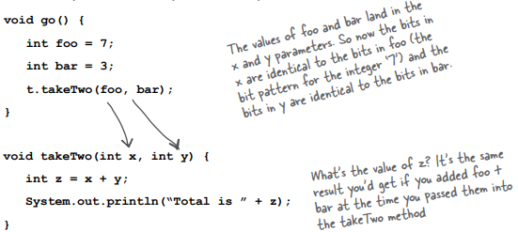
You can send more than one thing to a method. (2/n)
You can pass variables into a method, as long as the variable type matches the parameter type.

Slide 11

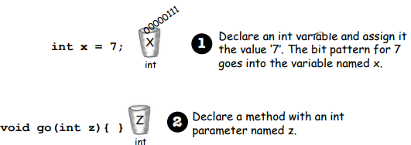
You can send more than one thing to a method. (3/n)
Java is pass-by-value.
That means pass-by-copy

Slide 12
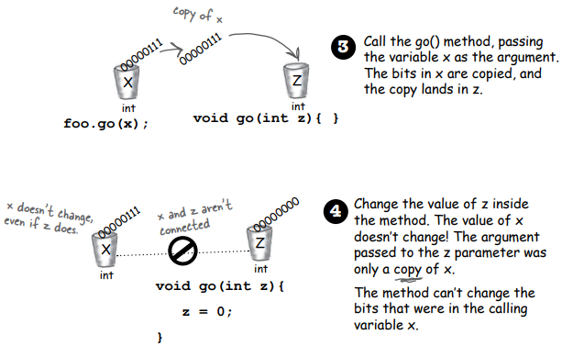
You can send more than one thing to a method. (4/n)

Slide 13
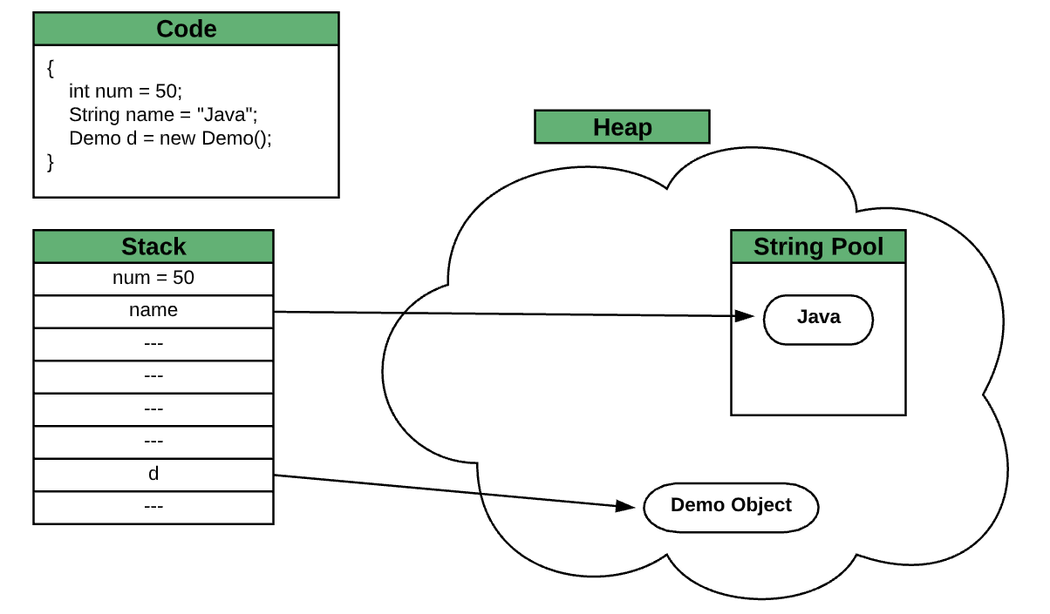
What is String pool ? (1/n)
String pool is nothing but a storage area in Java heap where string literals stores. It is also known as String Intern Pool or String Constant Pool. It is just like object allocation. By default, it is empty and privately maintained by the Java String class.
Whenever we create a string the string object occupies some space in the heap memory. Creating a number of strings may increase the cost and memory too which may reduce the performance also.

Slide 14
What is String pool ? (2/n)
The JVM performs some steps during the initialization of string literals that increase the performance and decrease the memory load. To decrease the number of String objects created in the JVM the String class keeps a pool of strings.
When we create a string literal, the JVM first check that literal in the String pool. If the literal is already present in the pool, it returns a reference to the pooled instance. If the literal is not present in the pool, a new String object takes place in the String pool.

Slide 15
What is String pool ? (3/n)
There are two ways to create a string in Java:
Using String Literal.
Using new Keyword.
String str1 = "Python";
String str2 = "Data Science";
String str3 = "Python";
String str1 = new String ("Java");
String str2 = new String ("C++");
String str3 = new String ("Data Science");

Slide 16
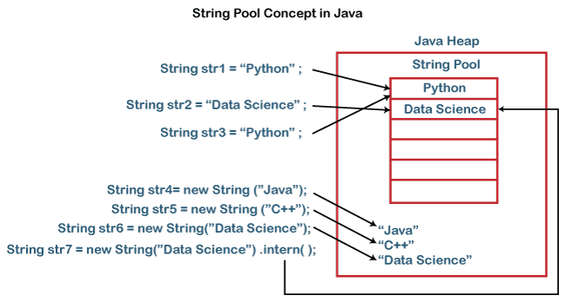
What is String pool ? (4/n)
Let's understand what is the difference between them. Let's compare the string literals' references.
s1==s3 //true
s2==s3 //false

Slide 17
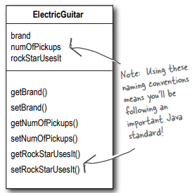
Encapsulation in an object. (1/n)
Cool things you can do with parameters and return types.
Getters and Setters. If you’re into being all formal about it, you might prefer to call them Accessors and Mutators. But that’s a waste of perfectly good syllables.
Besides, Getters and Setters fits the Java naming convention, so that’s what we’ll call them.
Getters and Setters let you, well, get and set things.

Slide 18
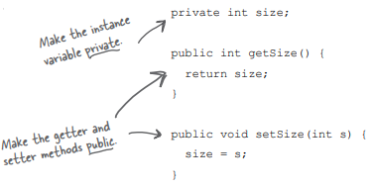
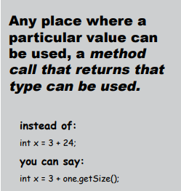
Encapsulation in an object. (2/n)
Even though the methods don’t really add new functionality, the cool thing is that you can change your mind later. you can come back and make a method safer, faster, better.

Slide 19
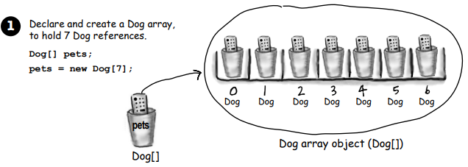
How do objects in an array behave ? (1/n)
Just like any other object. The only difference is how you get to them. In other words, how you get the remote control. Let’s try calling methods on Dog objects in an array.

Slide 20
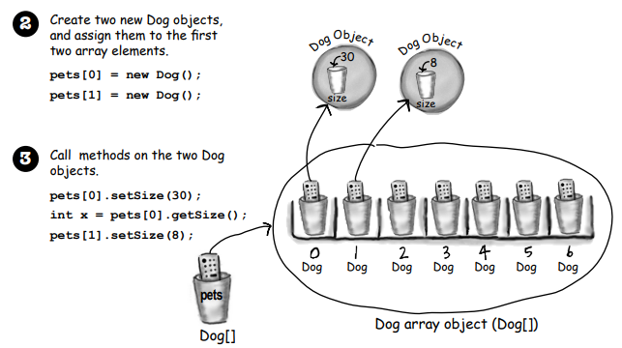
How do objects in an array behave ? (2/n)

Slide 21
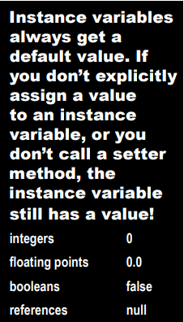
Declaring and initializing instance variables.
You already know that a variable declaration needs at least a name and a type:
int size;
String name;
And you know that you can initialize (assign a value) to the
variable at the same time:
int size = 420;
String name = “Donny”;

Slide 22
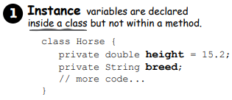
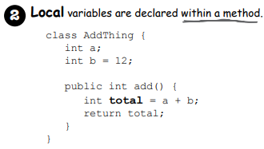
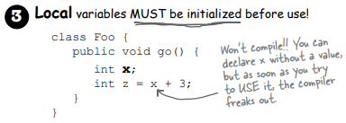
The difference between instance and local variables.
Local variables do NOT get a default value! The compiler complains if you try to use a local variable before the variable is initialized.

Slide 23
Reference
Head First book (page 71 - 88)
Website

Slide 24
Thank you!
Presented by Jahongir Sherjonov
(jakhongirsherjonov@gmail.com)

